Slide 1
DBMS System Structure and Data Model

Slide 2
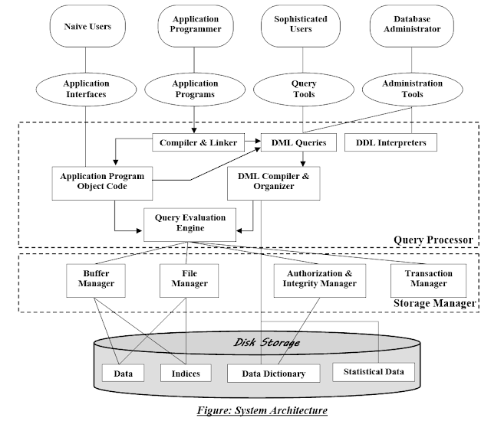
Database System Structure

Slide 3
Query Processor
Query processor helps the database system, simplify and facilitate access to data.
The work of query processor is to execute the query successfully.
It interprets the requests(queries) received from end user via an application program into instructions.
It also execute the user request which is received from the DML compiler

Slide 4
Query Processor Components
DDL Interpreter
It interprets the DDL statements(like schema definition) into a table containing data(data about data)
DML Compiler
It translates the DML statements(like select, insert, update, delete)into low level instructions, so that they can be executed
A query can usually be translated into any of a number of alternative evaluation plans that all give the same result. The DML compiler also performs query optimizations, that is it picks the lowest cost evaluation plan from among the alternatives.
Compiler and Linker
It processes DML statements embedded in a application program into procedural calls.
Query evaluation Engine
It executes the low level instructions generated by DML compiler

Slide 5
Storage Manager Components
Authorization Manager and Integrity Manager
It checks the authority of users to access data and checks the integrity constraints when the database is modified
Transaction Manager
It ensures that the database remains in a consistent state despite system failures, and that concurrent transaction executions proceed without conflicting
File Manager
It manages the allocation of space on disk storage and the data structures used to represent information stored on disk
Buffer manager
It responsible for fetching data from disk storage into main memory, and deciding what data to cache in main memory.

Slide 6
Disk Storage
The storage Manager implements the following data structures as a part of physical system implementations
Data Files
It stores the database itself
Data Dictionary
It contains the information about the structure of any database, Or it stores metadata about the database, in a particular the schema of the database.
Indices
It provides faster retrieval of data item
Statistical data
It stores statistical information about the data in the database. This information is used by the query processor to select efficient way to execute query

Slide 7
Data Models in Database
Data models define how the logical structure of a database is modelled and defines how data will be stored, accessed, and updates in database system. Data Model can be defined as an integrated collection of concepts for describing and manipulating data, relationships between data, and constraints on the data in an organization.
The purpose of a data model is to represent data and to make the data understandable.
We have different types of data models they are widely used data models.
  Hierarchal Model
  Network Model
  Entity-Relationship Model
  Relational Model

Slide 8
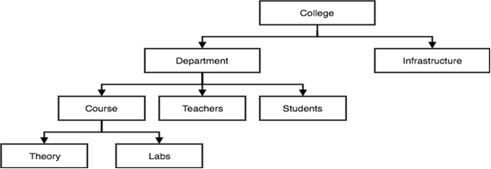
Hierarchical Model
The Hierarchical model arranges records in hierarchy like an organizational chart.
Each record type in this model is called node or segment.
A node represents a particular entity, the top most node is called root. Each node is a subordinate of the node that is at the next higher level.
A higher level node is called parent and lower level node is called child. A parent node can have one or more child nodes, but child can have only one parent node.
This kind of structure is often called inverted tree.

Slide 9
Drawbacks of Hierarchical Model
Relationship that are complex are not supported.
Because it only supports one parent per child node, if we have a complex relationship in which a child node needs to have two parents, we won’t be able to describe using this model.
When a parent node is removed, the child node is also removed.

Slide 10
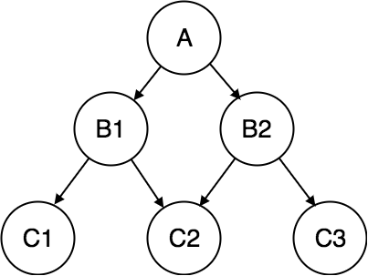
Network Model
The network model is similar to hierarchical model. The data are organized like graph
The difference is that child node can have more than one parent nodes.
The Child nodes are represented by arrows in network model.
It also provides more flexibility than hierarchical model.

Slide 11
Drawbacks
It is slow complex and more difficult to maintain.
It requires more complex diagram to represent a database.

Slide 12
Entity-relationship Model
ER model is a high-level data model diagram.
ER model describes the structure of a database with the help of a diagram, which is known as entity relationship Diagram(ER diagram)
An ER model is a design or blueprint of a database that can later be implemented as a database.
It is based on the notation of real world entities and relationship among them.
ER model follows 3 Component
Entities:- Entity is an real world things or object.
It can be a person, place or even a concept. It can be represented as rectangular shape.
Ex- Teacher, Student, Course, Building

Slide 13
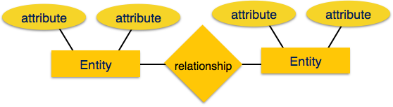
Contd….
Attributes:- An entity contains real world property called attribute. This is the characteristics of that attributes. This can be represented as eclipse.
Ex- The entity teacher has property like teacher_id, name, salary, age etc..
Relationship:- Relationship tells how the entities are related. Diamond or rhombus is used to represent the relationship.
Ex- Teacher works for department

Slide 14
Relational Model
This model was initially described by Edgar F.Codd in 1969.
Most widely used model by commercial data processing applications.
It uses collection of tables for representing data and the relationship among those data.
Data is stored in tables called Relations.
Each table is a group of column and rows where column represents attributes of an entity and rows represented records or tuples.
Attribute or Field:- Each column in a relation is called an attribute. The values of an attribute should be form the same domain.
Ex- Student_id, Student_name, Student_age
Tuple or record:- Each row in the relation called tuple. A tuple defines a collection of attribute values. So each row in a relation contains values.
Each row has all the information about any specific individual.

Slide 15
